Slide 1

8th Grade Math: Pre-Algebra
Unit 3, Lesson 4 Writing Small Numbers in Scientific Notation Volume 1, pg. 97

Slide 2


Benchmark
MA.8.NSO.1.4
Express numbers in scientific notation to represent and approximate very large or very small quantities. Determine how many times larger or smaller one number is compared to a second number.
volume 1, pg. 97

Slide 3
Integrated Mathematical Thinking and Reasoning Standards
MA.K12.MTR.3.1 Complete tasks with mathematical fluency.
MA.K12.MTR.5.1 Use patterns and structure to help understand and connect mathematical concepts.
MA.K12.MTR.7.1 Apply mathematics to real-world contexts.
volume 1, pg. 97

Slide 4

Learning Targets
I can express small numbers in scientific notation.
I can determine how many times larger or smaller a number is compared to another expressed in scientific notation.
volume 1, pg. 97

Slide 5

Warm-Up
volume 1, pg. 98

Slide 6
3.4.1 Warm-Up: Math Mindset
In the story of The Tortoise and the Hare, the hare had a fixed mindset while the tortoise had a growth mindset.
“Failure is an almost essential step to success.” Describe a time in which you experienced failure before reaching success.
What can you do to overcome the thoughts of, “I’m not good at ______.” or “I can’t ______.”?
volume 1, pg. 98
Notes:
Video Link: https://algebranation.wistia.com/medias/fi4fidi5y8

Slide 7

Guided Instruction
volume 1, pg. 98

Slide 8

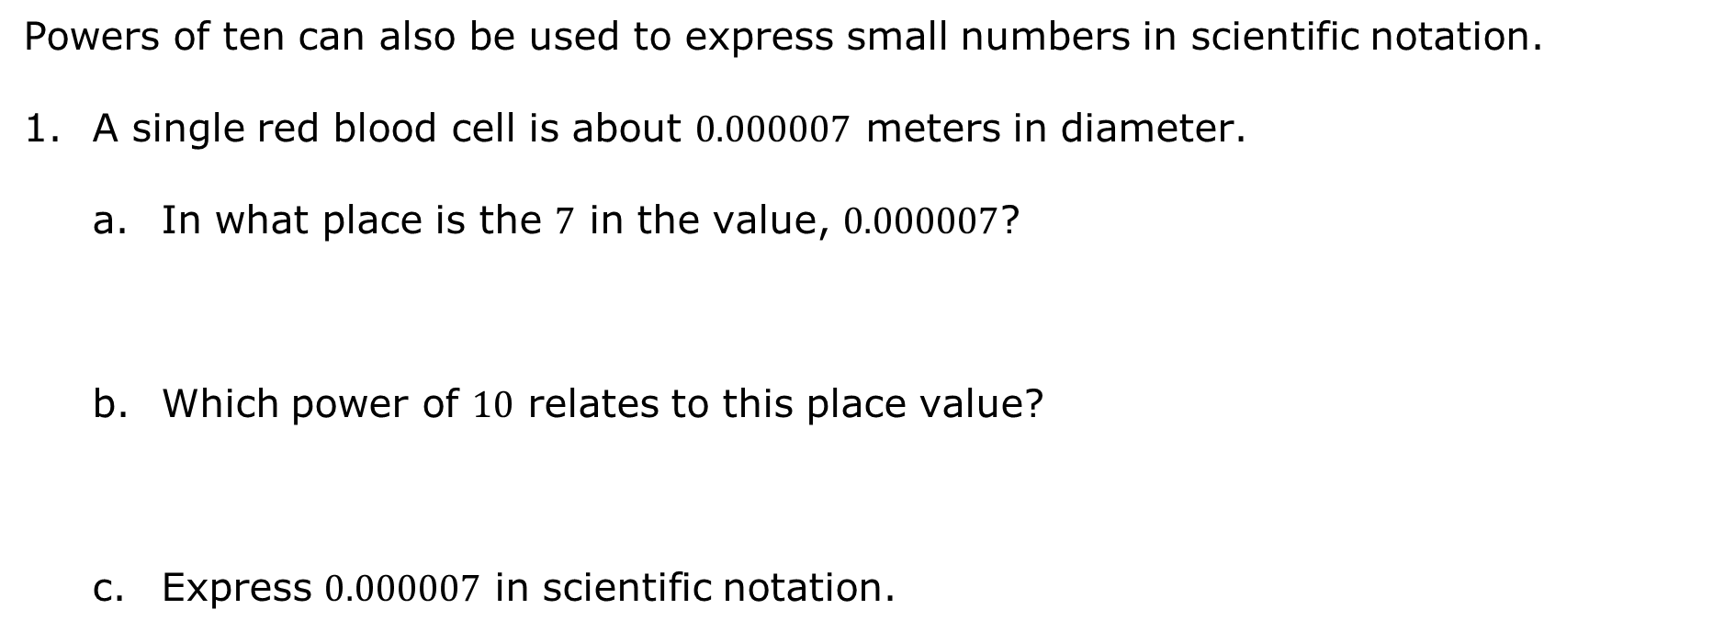
3.4.2 Guided Instruction: Writing Small Numbers in Scientific Notation
Powers of ten can also be used to express small numbers in scientific notation.
A single red blood cell is about $0.000007$ meters in diameter.
In what place is the $7$ in the value, $0.000007$?
Which power of $10$ relates to this place value?
Express $0.000007$ in scientific notation.
volume 1, pg. 98

Slide 9
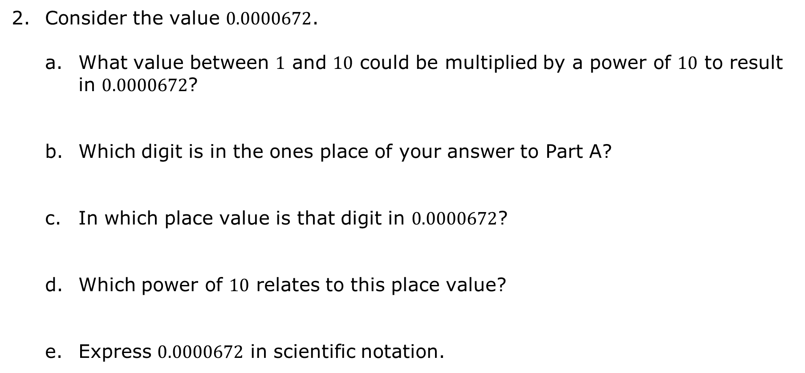
Consider the value $0.0000672$.
What value between $1$ and $10$ could be multiplied by a power of $10$ to result in $0.0000672$?
Which digit is in the ones place of your answer to Part A?
In which place value is that digit in $0.0000672$?
Which power of $10$ relates to this place value?
Express $0.0000672$ in scientific notation.
volume 1, pg. 99

Slide 10
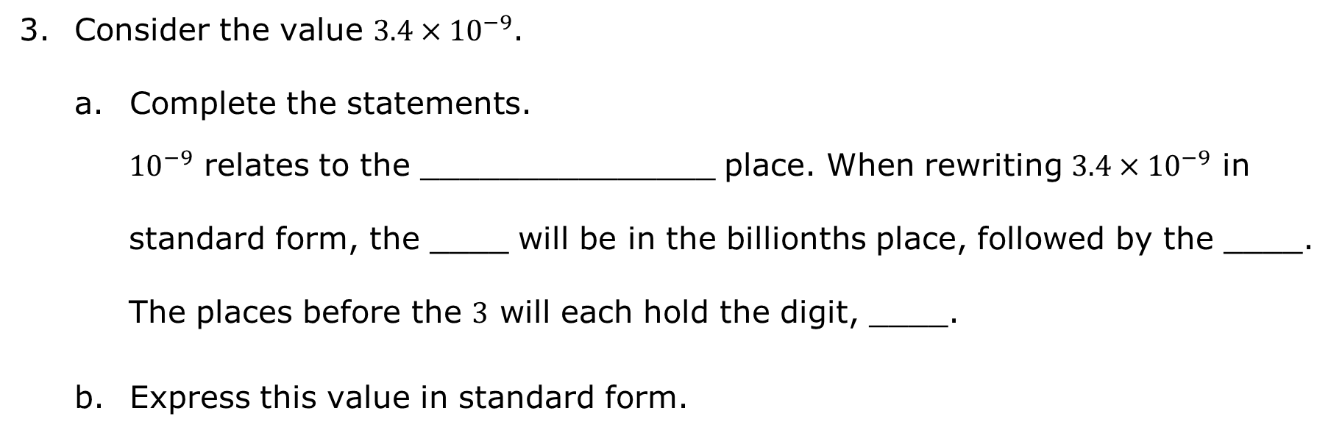
Consider the value ${3.4×10}^{−9}$.
Complete the statements.
${10}^{−9}$ relates to the _______________ place. When rewriting ${3.4×10}^{−9}$ in standard form, the ____ will be in the billionths place, followed by the ____. The places before the $3$ will each hold the digit, ____.
Express this value in standard form.
volume 1, pg. 99

Slide 11

Guided Practice
volume 1, pg. 99

Slide 12

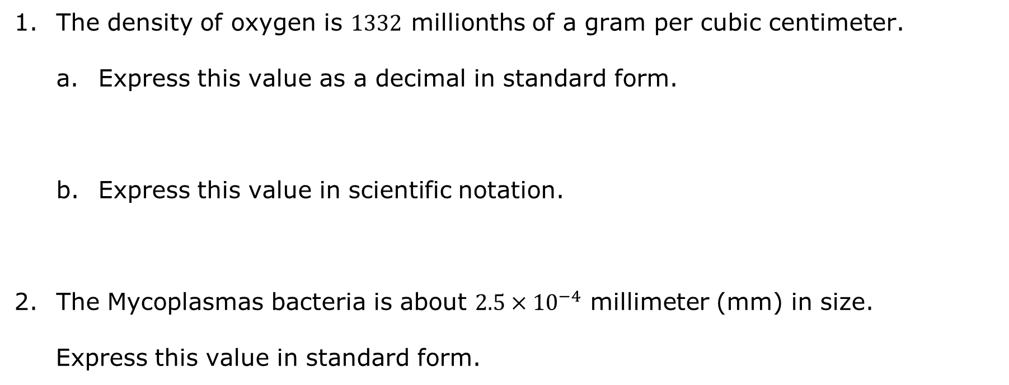
3.4.3 Guided Practice: Writing Small Numbers in Scientific Notation
The density of oxygen is $1332$ millionths of a gram per cubic centimeter.
Express this value as a decimal in standard form.
Express this value in scientific notation.
The Mycoplasmas bacteria is about $2.5×{10}^{−4}$ millimeter (mm) in size.
Express this value in standard form.
volume 1, pg. 99

Slide 13

Collaboration
volume 1, pg. 100

Slide 14

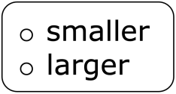
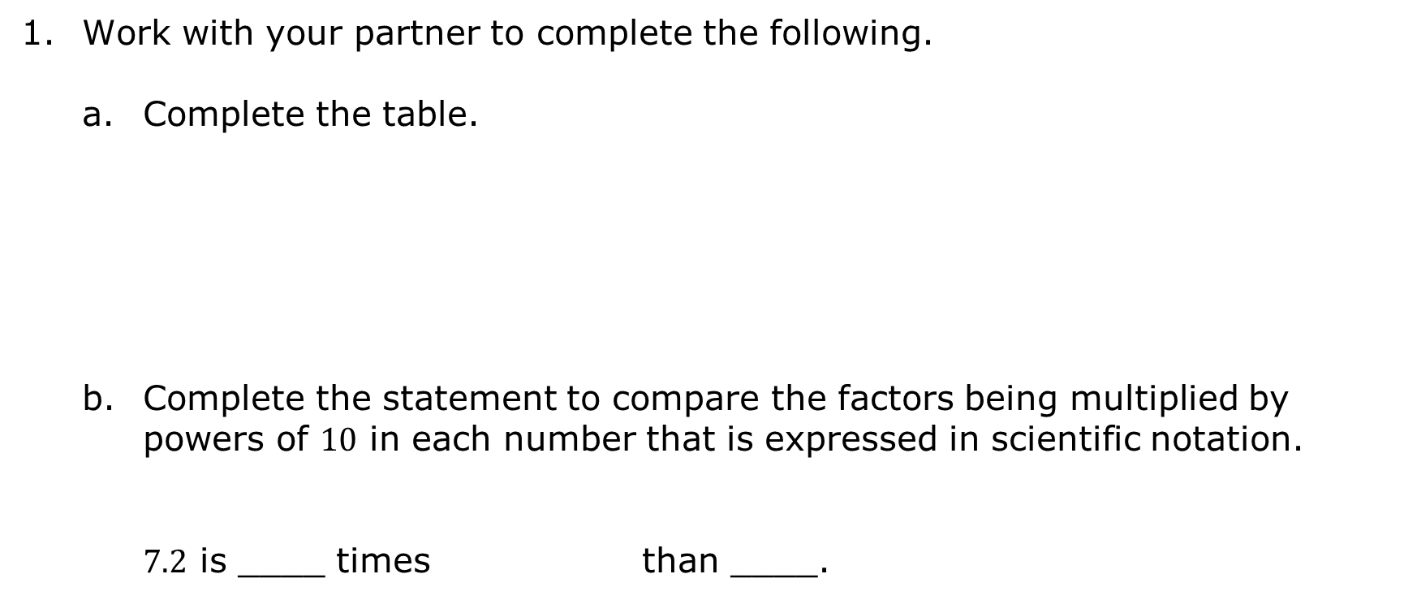
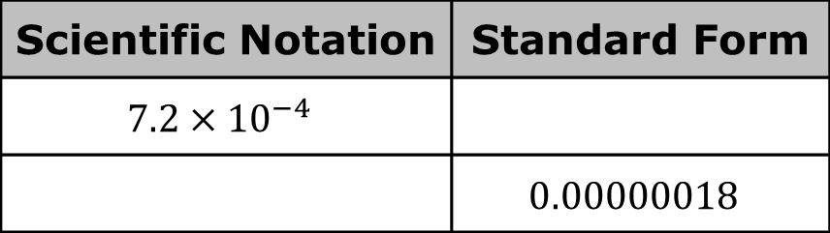
3.4.4 Collaboration: Comparing Small Numbers Written in Scientific Notation
Work with your partner to complete the following.
Complete the table.
Complete the statement to compare the factors being multiplied by powers of $10$ in each number that is expressed in scientific notation.
$7.2$ is ____ times than ____.
Scientific Notation | Standard Form
$$7.2×{10}^{−4}$$
 | $$0.00000018$$
volume 1, pg. 100

Slide 15
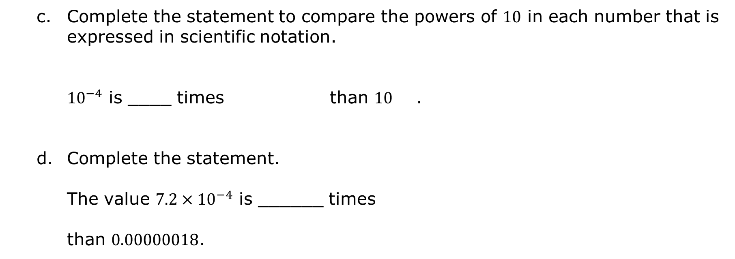
Complete the statement to compare the powers of $10$ in each number that is expressed in scientific notation.
${10}^{−4}$ is ____ times than $10$ .
Complete the statement.
The value $7.2×{10}^{−4}$ is ______ times than $0.00000018$.
volume 1, pg. 100

Slide 16

Your Turn
volume 1, pg. 100

Slide 17
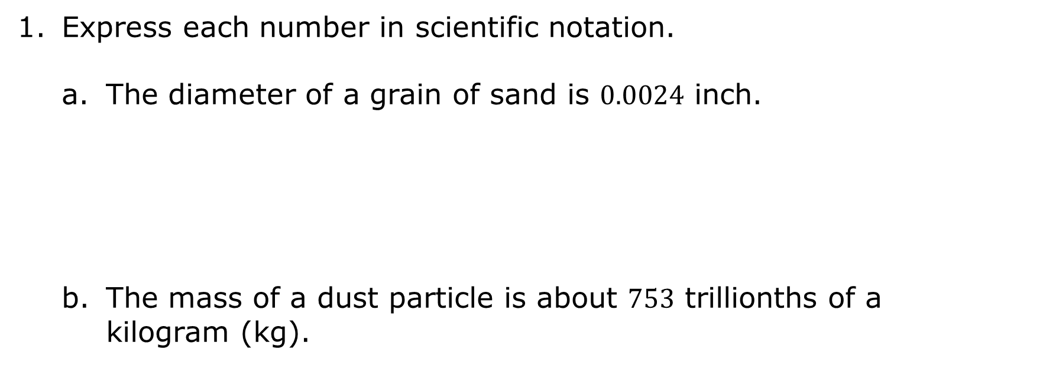
3.4.5 Your Turn!
Express each number in scientific notation.
The diameter of a grain of sand is $0.0024$ inch.
The mass of a dust particle is about $753$ trillionths of a kilogram (kg).
volume 1, pg. 100

Slide 18

Express each number in standard form.
$3 × {10}^{−8}$
$1.2379 ×{10}^{−1}$
volume 1, pg. 100

Slide 19

Wrap-Up
volume 1, pg. 101

Slide 20
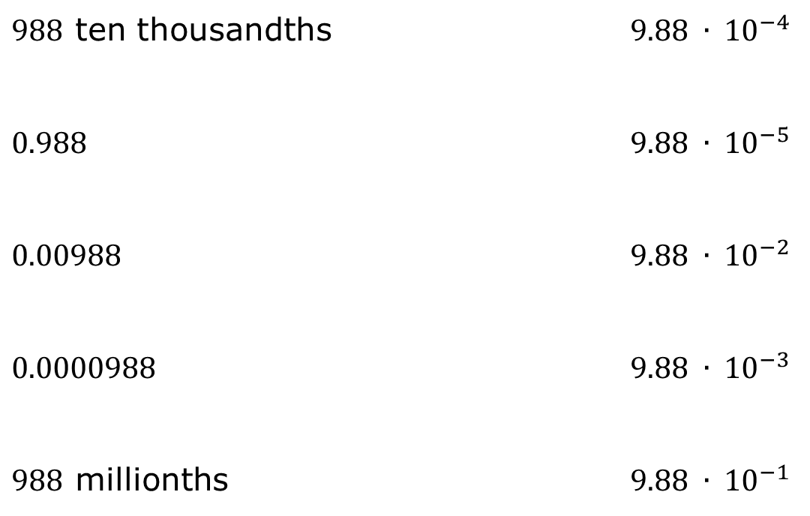
3.4.6 Wrap-Up: Ticket Out the Door
Match each value on the left with its expression in scientific notation on the right by drawing lines to connect the equivalent expressions.
$988$ ten thousandths | $$9.88 ∙ {10}^{−4}$$
$$0.988$$ | $$9.88 ∙ {10}^{−5}$$
$$0.00988$$ | $$9.88 ∙ {10}^{−2}$$
$$0.0000988$$ | $$9.88 ∙ {10}^{−3}$$
$988$ millionths | $$9.88 ∙ {10}^{−1}$$
volume 1, pg. 101

